Slide 1

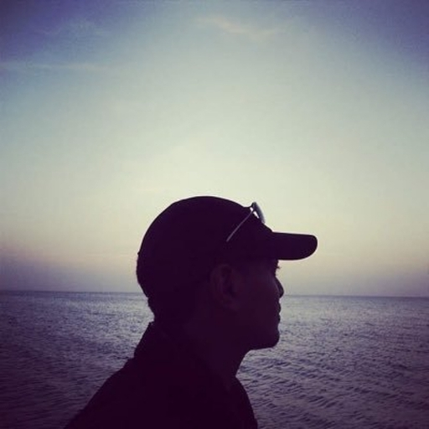

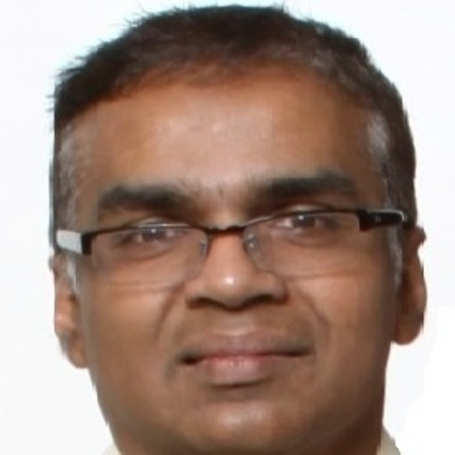
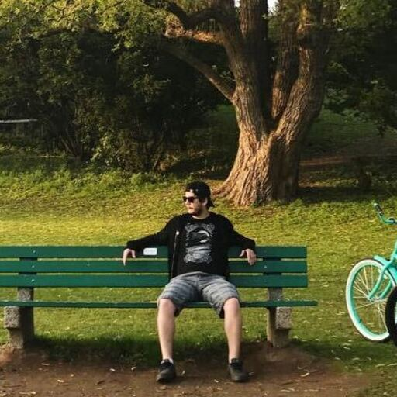

STUDIOUS.LY
Aar
Shamsher
Amar
Victor
Arshleen
Notes:
VICTOR: Hi All, Thank you all for listening to us talk about our new application - Spooky Sights.

Slide 2
What is STUDIOUS.LY?
An application that helps you reach your studying goals
An application that keep you alert of your stress load
Notes:
VICTOR: So, what have we created?
Our application is called Spooky Sights! The app allows you to search for various haunting experiences in your area, where you can read about other people’s experiences. And, if you login, you can add your own reviews.

Slide 3
USER STORY
AS A user who is interested in focusing on their work
I WANT an application that helps me focus and helps me define my schedule
SO THAT I can be more efficient with my time management
Notes:
VICTOR: Our User Story is for any user who is interested in knowing about the spooky areas near them.

Slide 4
PROCESS
Challenges
Successes
Front-End
Took some time in getting to grips with TailWind
Fantastic visual outcomes
GraphQL
Difficulty in building routes & kept wanting to use traditional routes method!
With a little persistence and help, was able to get the graphql & apollo server up and running
Clean-up
Merging our separate pages together and ensuring smooth transitions
Deploying on Heroku
Able to use get the desired look and feel of the page
Notes:
ARSHLEEN: During this project, we faced a lot of difficulties and issues. We have laid out only a few here.
Each of us faced problems and errors in the code, from setting up the server to the final edits at the end.
But finally, we were able to manage and fix all our concerns to develop a working application that meets our standards.
The server setup was done by Arshleen. Khaleel was responsible for the complete database setup, whilst Summer was charged with working with Handlebars.js to setup the complete front-end and Victor created all the routes and authentication process.
The core technologies that we used were of course:
NodeJS, ExpressJS, OOPS concepts and MVC paradigms.

Slide 5
DEMO
Notes:
SUMMER: Now, we are going to take a look at the actual way the webpage works.
This is our webpage.
At the top of the screen, we have our login buttons. If you would like to write a review, then you need to make sure that you are signed in.
You can select the name of the city and the state that you are interested in knowing more about and you are then directed to a list of spooky sights!
As you can see, we have some reviews that you can read.
If you would like to add your own review, you have to login, then add you review like this.

Slide 6
FUTURE DEVELOPMENT
Add a tutor page & study group page that connects you with tutors in your local area that can help further with your studies / study groups that have the same requirements
Expand the scope of Studious.ly to include helpful tips & advice to students / worker to help increase efficiencies
2022
Q2
2022
Q4
2022 Q1
2022
Q3
Build an API to block websites that cause distractions for both browser and mobile application
Connect to sentiment analysis API that tracks more info about user and their goals
Notes:
KHALEEL: We have a lot of ideas about the future plans of Spooky Sights. This is a timeline for what we hope to achieve over the next 1 year.
We would like to expand our availability to all of North America and Europe. This will give more opportunity to people view their local spooky sights!
We hope to expand our application to give information about more ’family-friendly’ attractions that near them. This includes, haunted theme park rides, pumpkin patches, hayrides, etc.
We aim to also give you an opportunity to rent out your local spooky sight through our application. If you want to hold a part or stay overnight at any spooky sight, you can book it through our site.
Finally, we want to give our frightful users the opportunity to buy haunted merchandise from us or access our list of ghostly vendors!

Slide 7
THANK YOU FOR LISTENING
STUDIOUS.LY
Notes:
VICTOR: Hi All, Thank you all for listening to us talk about our new application - Spooky Sights.

